Slide 1
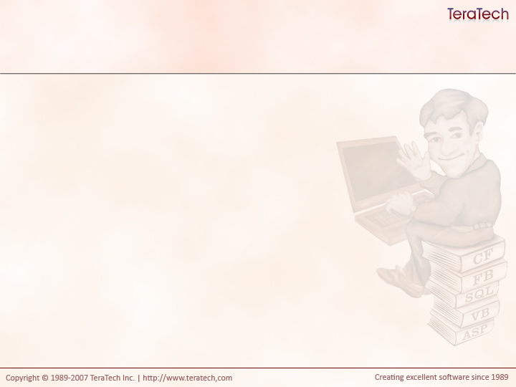
Let’s Port!
Moving Procedural Code to Model-Glue and Supporting Technologies

Slide 2
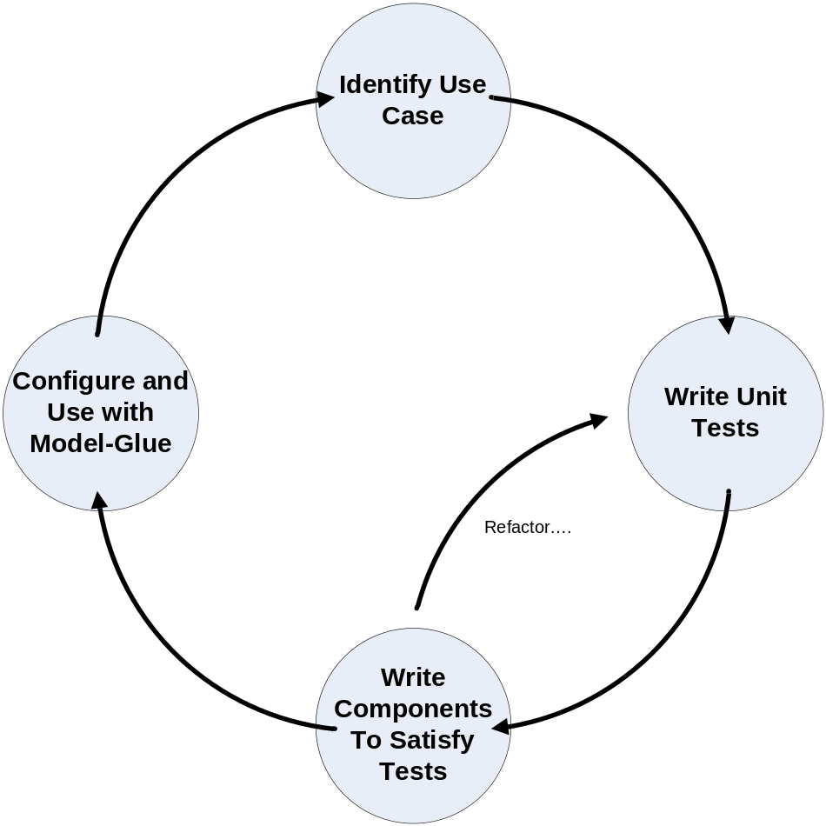
The Process…

